Slide 1
Driving Efficiency and Agility
Exploring the Power of the 12-Factor App
by Evren Tan

Slide 2


Slide 3

About Me

Slide 4
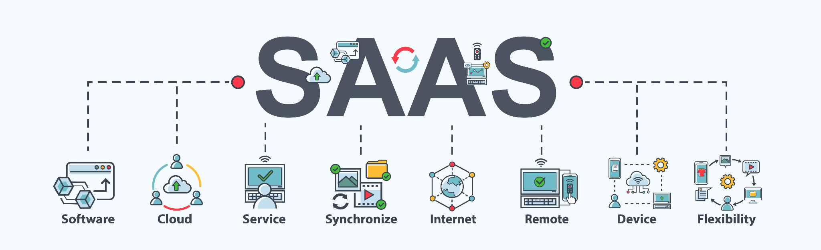

12-Factor App?
⭐️ A methodology for building SaaS apps that:
Use declarative formats for setup automation, to minimize time and cost for new developers joining the project;
Have a clean contract with the underlying operating system, offering maximum portability between execution environments;
Are suitable for deployment on modern cloud platforms, obviating the need for servers and systems administration;
Minimize divergence between development and production, enabling continuous deployment for maximum agility;
And can scale up without significant changes to tooling, architecture, or development practices.
The twelve-factor methodology can be applied to apps written in any programming language, and which use any combination of backing services (database, queue, memory cache, etc).
⭐️ ➡️ https://12factor.net/

Slide 5
And these factors are;
Codebase
Dependencies
Config
Backing Services
Build, Release & Run
Processes
Port Binding
Concurrency
Disposability
Dev/Prod Parity
Logs
Admin Processes

Slide 6
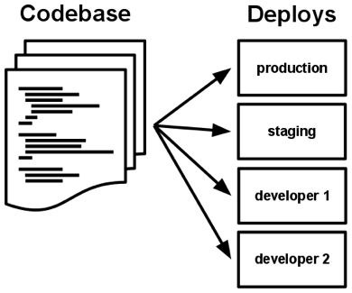
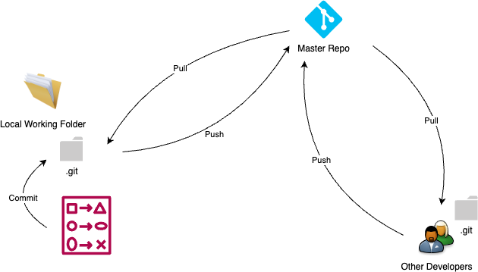
Codebase
❌ Multiple Codebases ≠ One App ➡️ A Distributed System
❌ Multiple Apps Sharing the Same Codebase
✅ One Codebase per App with Many Deploys
https://12factor.net/codebase

Slide 7
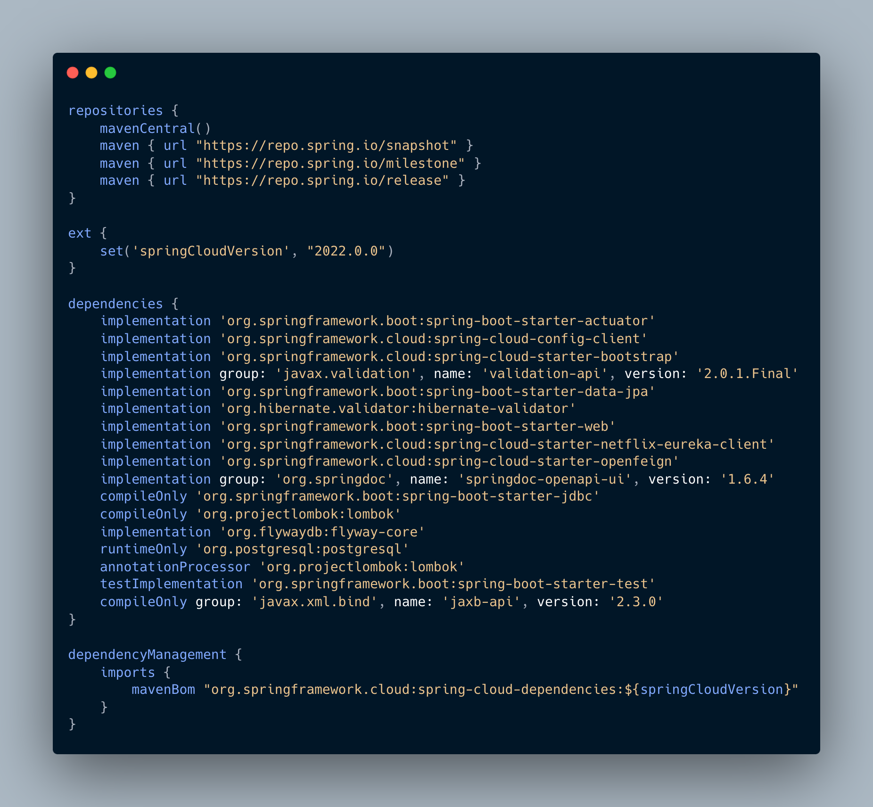
Dependencies
❗️A 12-factor app never relies on implicit existence of system-wide packages.
✅ It declares all dependencies, completely and exactly, via a dependency declaration manifest.
🧰 A dependency isolation tool

Slide 8
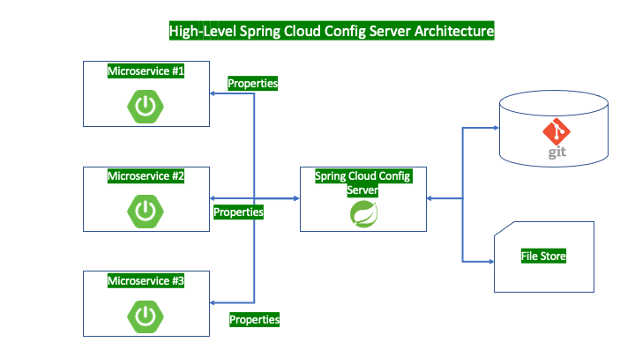
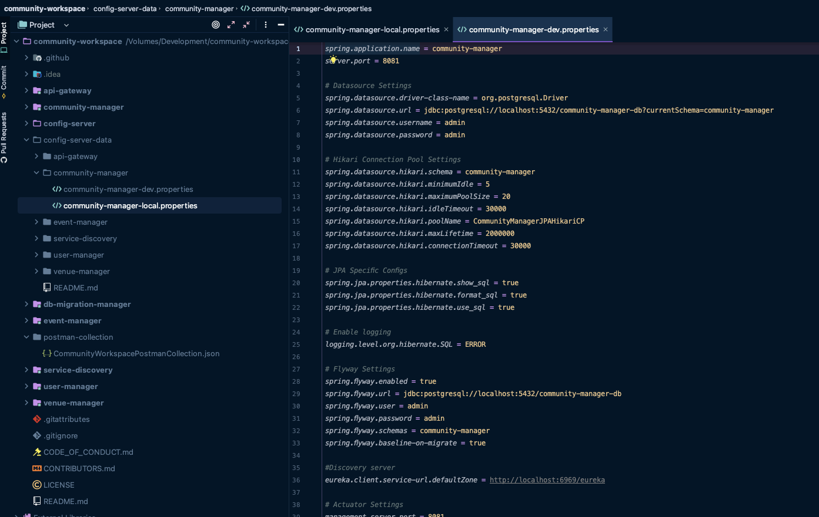

Config
❓Store configs static in the codebase ❌
✅ Strict Separation Config from the Codebase
✅ The twelve-factor app stores config in environment variables
♻️ Group configs in the same batch, i.e., dev, test, staging, production

Slide 9
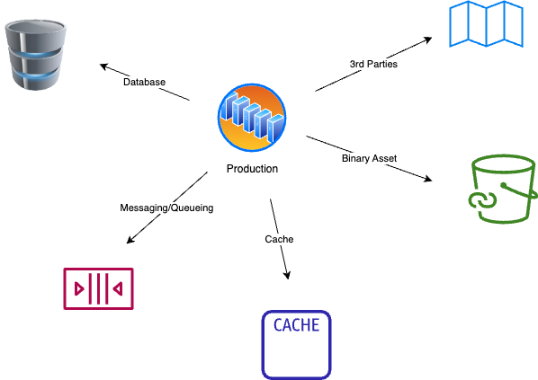
Backing Services
ℹ️ A backing service is any service the app consumes over the network as part of its normal operation.
➡️ Databases (PostgreSQL, MongoDB), Messaging/Queueing Services (Kafka, RabbitMQ), Caching (Redis), Metrics Gathering (New Relic, Loggly), Binary Asset Services (Amazon S3), API accessible 3rd Parties (Twitter, Google Maps, etc)
⭐️ Treat backing services as attached resources
🌟 Resources must be designed according to loose coupling pattern

Slide 10
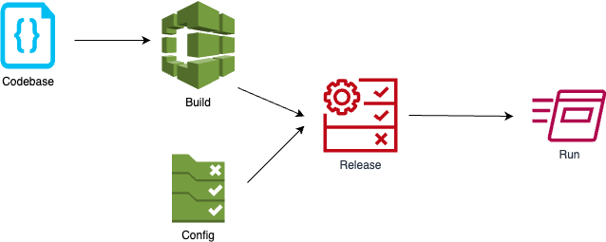
Build, Release & Run
❗️Strictly separate build, release and run stages
ℹ️ Three stages;
Build Stage
Release Stage
Run Stage

Slide 11
Processes
⭐️ Twelve-factor processes are stateless and share-nothing.
⭐️ Any data that needs to persist must be stored in a stateful backing service, typically a database.
✅ Execute the app as one or more stateless processes

Slide 12
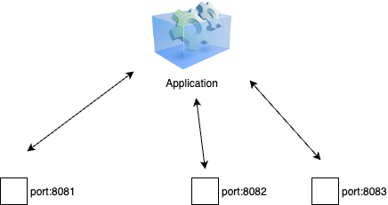
Port Binding
⭐️ Export services via port binding
ℹ️ Improves an application’s portability and security
🧐 An App has three services and all binds to different ports ❓
Scalability, portability, security, routing, load balancing (container native load balancing)
❓Treats like a backing service. Think about a Java app behind a Nginx web server

Slide 13
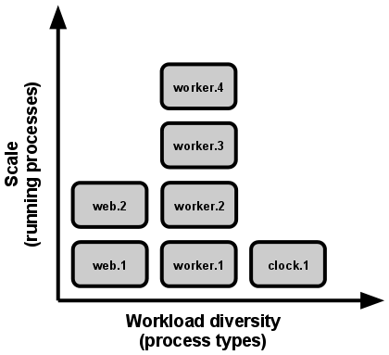
Concurrency
⭐️ Scale out via the process model
🥇 Processes are a first class citizen for a 12-Factor App
🏗️ The developer can architect their app to handle diverse workloads by assigning each type of work to a process type.
HTTP requests may be handled by a web process, and long-running background tasks handled by a worker process.
https://12factor.net/concurrency

Slide 14
Disposability
⭐️ Maximize robustness with fast startup and graceful shutdown
ℹ️ Processes are disposable, meaning they can be started or stopped at a moment’s notice.
⚖️ Fast elastic scaling
💻 Rapid deployment of code or config changes
💪🏻 Robustness of production deploys
💥 A 12-Factor app is architected to handle unexpected, non-graceful terminations ➡️ Crash-only Software ➡️ A software that crashes safely and recovers quickly

Slide 15
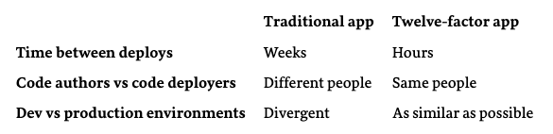
Dev/Prod Parity
⭐️ Keep development, staging, and production as similar as possible
ℹ️ The 12-factor app is designed for continuous deployment by keeping the gap between development and production small ➡️ Smaller Feedback Loop
❗️The twelve-factor developer resists the urge to use different backing services between development and production
🐳 Containerization tools like Docker

Slide 16
Logs
⭐️ Treat logs as event streams
ℹ️ Logs are the stream of aggregated, time-ordered events collected from the output streams of all running processes and backing services
❗️ A 12-factor app never concerns itself with routing or storage of its output stream
❌ Write to or manage log files in the local file system
✅ Write to STDOUT as unbuffered data

Slide 17
Admin Processes
ℹ️ What are Admin Processes;
Running DB migrations
Running reports
Running one-time scripts committed into the app’s repo
⭐️ Run admin/management tasks as one-off processes
✅ Each one of those processes should be run against a new instance having identical configs with the app
❗️Ensures that those background tasks do NOT have impact on the standard process

Slide 18

Q&A

Slide 19

Quiz Time :)
https://form.jotform.com/evrentan/the-12-factor-app-quiz

